Slide 1
A Novel Approach For The Evaluation Of Facial Asymmetry Of Unilateral Cleft Lip And Palate Patients (UCLP).
Dhelal Al-Rudainy,
Xiangyang Ju, Felicity Mehendale, Ashraf Ayoub
Glasgow University, Lothian Health Board

Slide 2
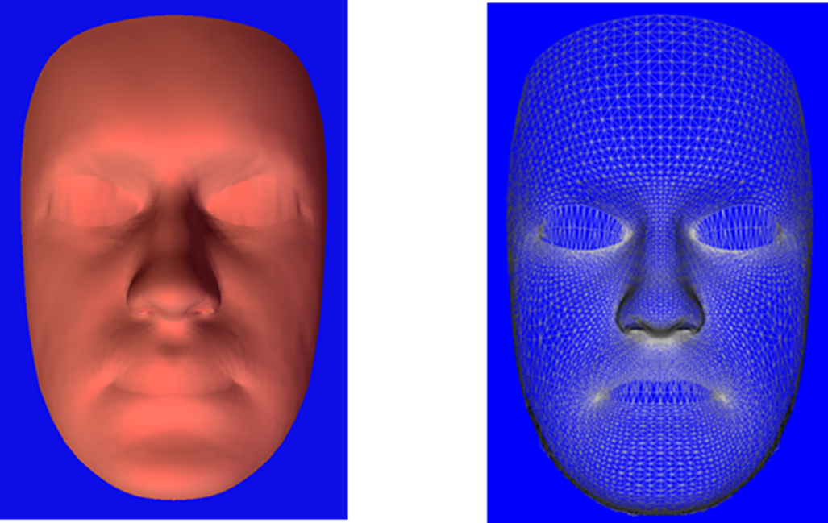
Aim:
to assess the impact of primary lip surgery, in UCLP, on facial asymmetry using a generic facial mesh.
To measure surgical improvement.
To identify residual asymmetries.

Slide 3
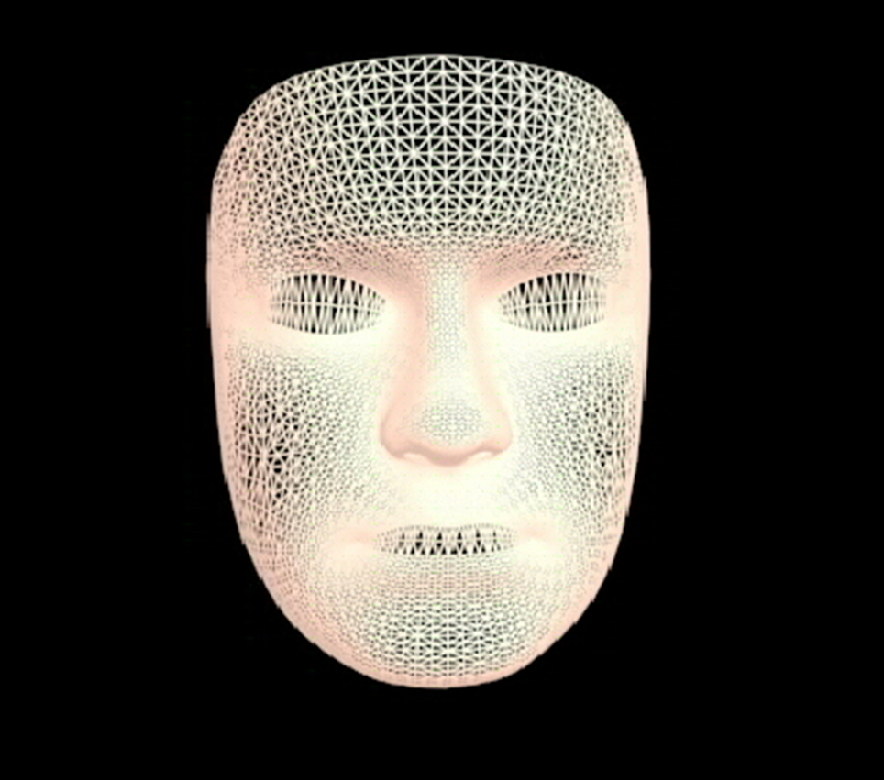
Generic mesh

Slide 4
Study sample:
26 images
before surgery
26 images
after surgery
(4 months after surgery)
26 UCLP Cases

Slide 5
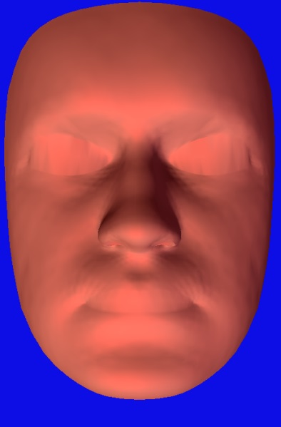
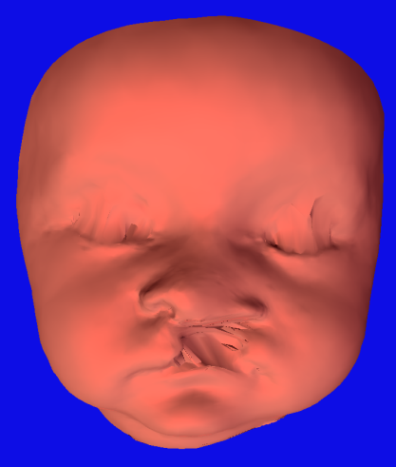
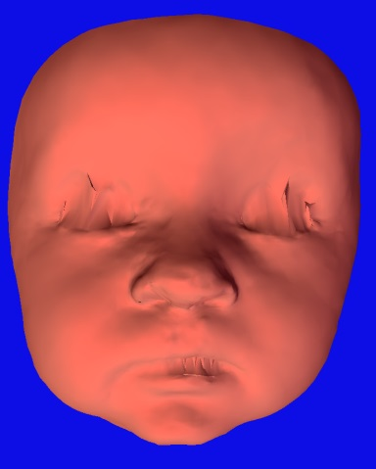
A: Generic mesh
B: Pre-operative conformed mesh
C: Post-operative conformed mesh
The Generic mesh (A) was conformed on the Pre-operative facial model (B) and the post-operative facial model (C).

Slide 6
Results
Average asymmetry at rest
Average asymmetry at maximum smile

Slide 7
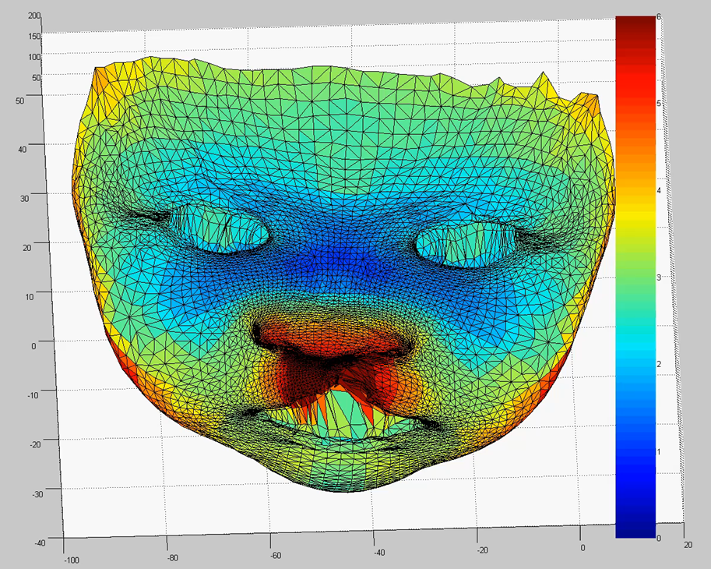
The average distances between the corresponding points of the original and their mirror images preoperatively
Average asymmetry at rest
Average asymmetry at maximum smile

Slide 8
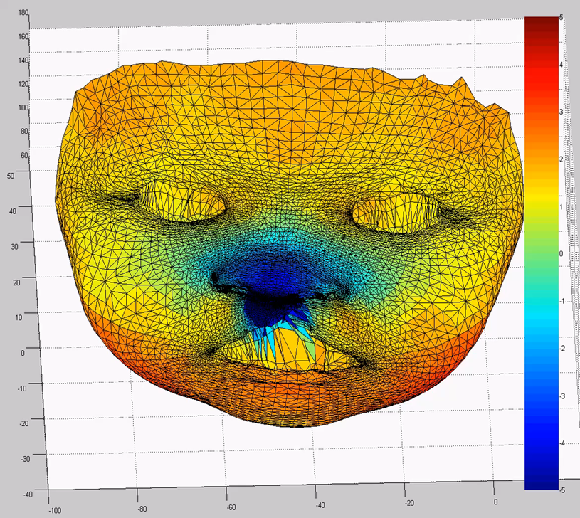
Average mediolateral asymmetry preoperatively.
Average asymmetry at rest
Average asymmetry at maximum smile

Slide 9
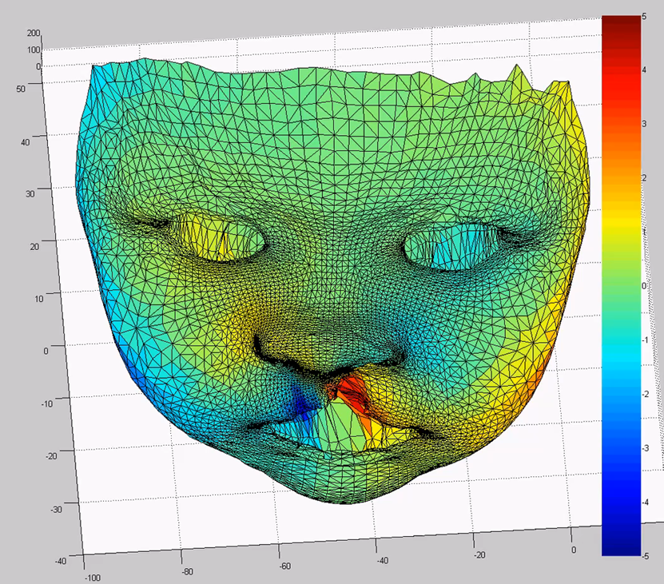
Average vertical asymmetry preoperatively.
Average asymmetry at rest
Average asymmetry at maximum smile

Slide 10
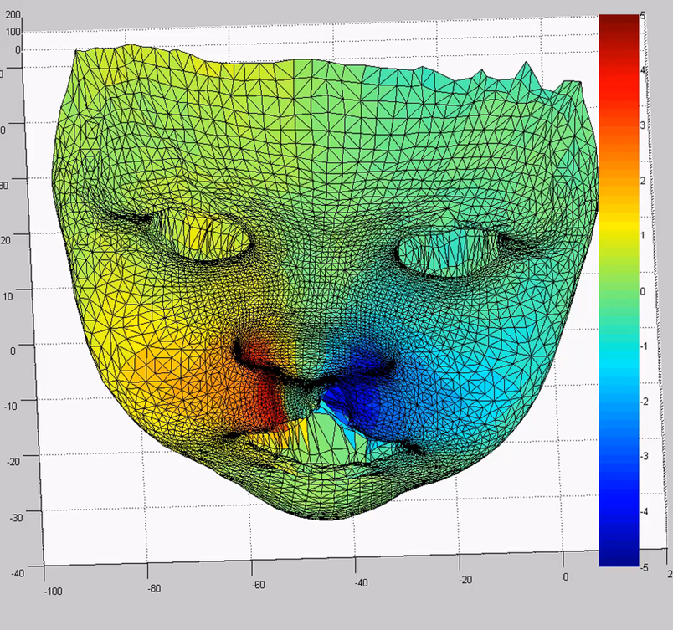
Average anteroposterior asymmetry preoperatively.
Average asymmetry at rest
Average asymmetry at maximum smile

Slide 11
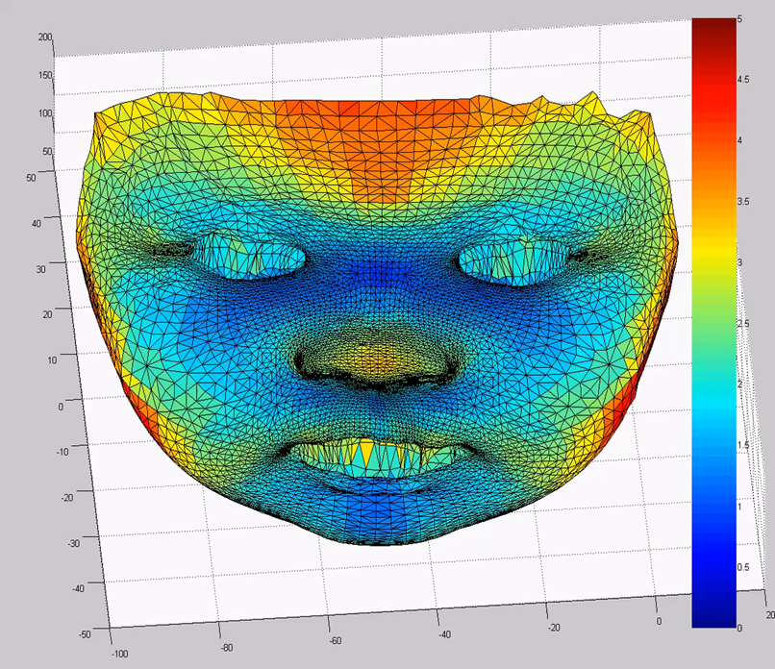
The average distances between the corresponding points of the original and their mirror images postoperatively
Average asymmetry at rest
Average asymmetry at maximum smile

Slide 12
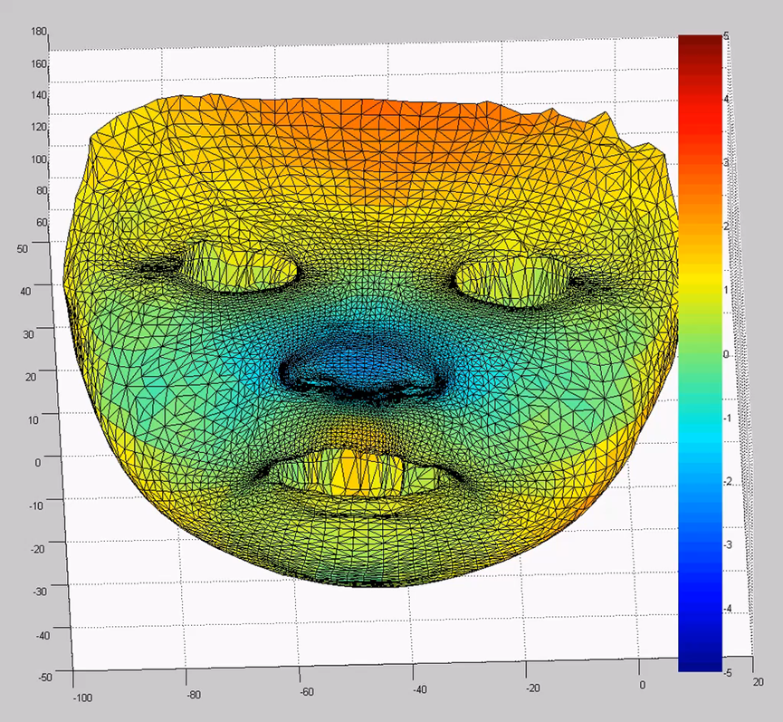
Average mediolateral asymmetry postoperatively.
Average asymmetry at rest
Average asymmetry at maximum smile

Slide 13
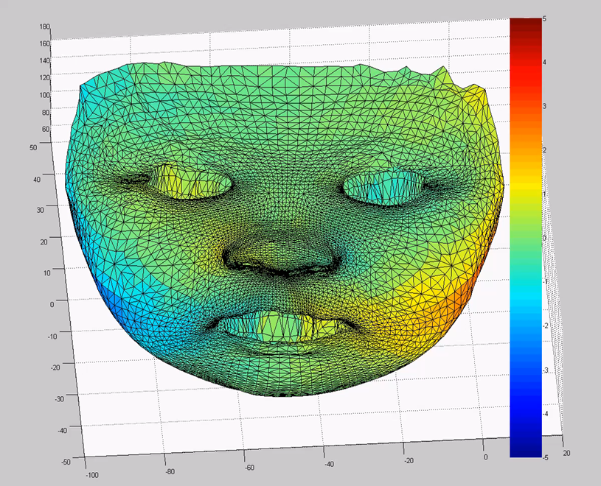
Average vertical asymmetry postoperatively.
Average asymmetry at rest
Average asymmetry at maximum smile

Slide 14
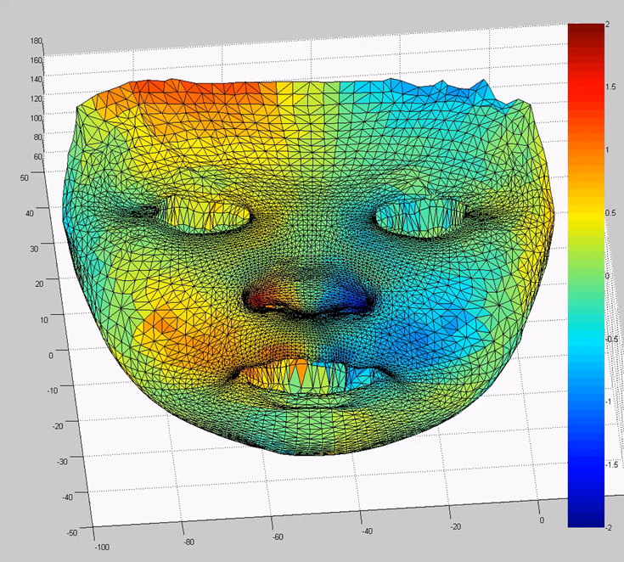
Average anteroposterior asymmetry postoperatively.
Average asymmetry at rest
Average asymmetry at maximum smile

Slide 15
Conclusions:
Primary lip surgery of unilateral cleft lip improved facial symmetry
Facial asymmetry could be identified vertically, horizontally and mediolaterally.
The conformed generic mesh is a reliable and innovative tool for comprehensive facial analysis.

Slide 16
?
Would facial growth accentuate or reduce facial symmetry of UCLP?

Slide 17
Thank you

